Slide 1
Resolving Complex Medicaid Cases Appeals & Reconsiderations
Kyle Fisher
KFisher@phlp.org
October 2016

Slide 2
Topics
Appeals
Mechanics
Resolving
Common denials
Reconsideration
Applications
Expediting in medical emergency
Notes:
Goal is help consumers gain coverage – advocating at CAO level. Certain rules of the game.

Slide 3
Preface
Rule #1 – Develop Contacts
Unlike the HC.gov black box
County Assistance Offices (CAOs) are staffed by human beings
Who have huge caseloads
Who sometimes make mistakes
Who often can be reached by phone or email
Who have no interest in going to fair hearings
Rule #2 – Treat your CAO contacts well
Be credible
Make their jobs easy
Notes:
Opposite of HC.gov algoritms, call center staff who can’t explain the black box’s decision
you may be new, but at times you will know the rules better than they do; tactfully inform them
most of the state / starting point is MA ombudsman :: phila – advocate liaisons
DHS directory (word format)

Slide 4
Appeals
Mechanics & strategies

Slide 5
Appeals
Why not just reapply?
Filing an appeal …
Begins a formal legal proceeding
Creates leverage
Makes the CAO review its action
Most appeals are resolved quickly

Slide 6
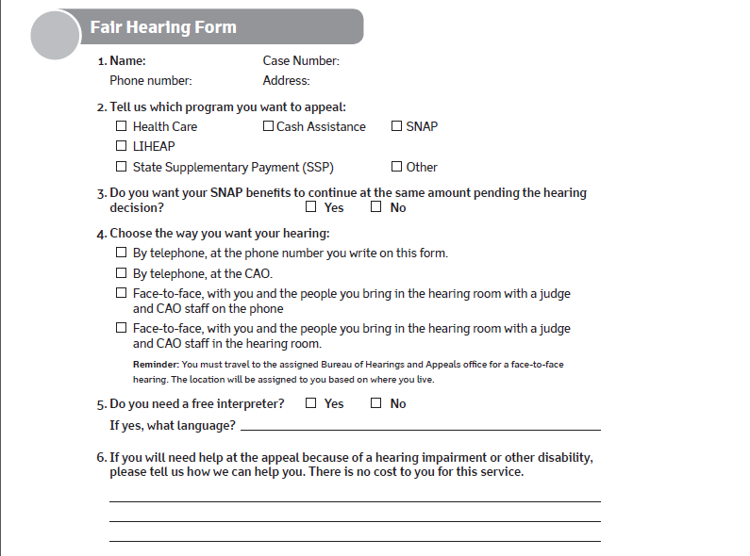
Mechanics (1 of 2)
Best to use the form attached to the denial, which is pre-populated.
Selecting in-person gives the CAO more incentive to resolve the issue

Slide 7
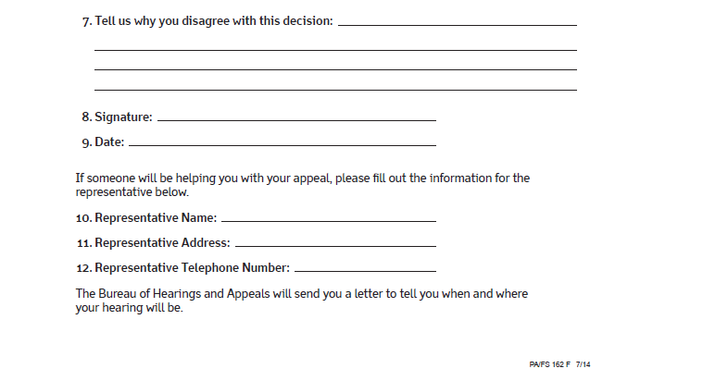
Mechanics (2 of 2)
A cover letter/email helps. Cite the MAEH, and/or explain the attached information.
I disagree. My income information is attached.
The client has to sign. Being listed as a “representative” gives you authority to act on the client’s behalf.

Slide 8
Mechanics
How should the appeal be filed?
Hand-delivered
By certified mail
By email, or
By fax
Call or email within a day or two
Confirm the appeal was received
Attempt to resolve – “Is any additional information needed?”
Best
Confirm receipt
Notes:
Protect the date of application – especially if recent bills, need retroactive coverage

Slide 9
Mechanics
30 days
Time the client has to file an appeal
Runs from date of adverse action notice
13 days
“aid-paid-pending” or “benefits continuing” deadline
Where the CAO is stopping coverage already in place
Benefit has to continue pending the appeal
Notes:
[Include Compass e-form#, if you have it] – or date reports filing

Slide 10
Mechanics
90 days
Time the state has to schedule and hold a fair hearing and issue a written decision
Runs from date of appeal
Immediately
How quickly you can attempt to resolve an appeal
No need to wait for a formal “pre-hearing conference”

Slide 11
Strategies
Make it easy for the CAO to fix the problem
Submit (or re-submit) missing information with the appeal
It doesn’t matter if it’s “late” (55 pa code 275.5)
Cite the relevant MAEH section
If need be, go up the chain of command
Do not wait weeks for a caseworker to respond
Especially where medical emergency, e.g.
Notes:
- paperwork gets lost / may need to submit 3x!
- Q not whether right at time, but whether have what they need NOW

Slide 12
Strategies
Humanize your client
Include information about health conditions, e.g.
Even if not technically relevant
Power in narrative
Keep PHLP in mind
Notes:
- you’re trying to motivate the caseworker/supervisor/administrator to prioritize your client

Slide 13
Sample email / cover letter
From: Kyle Fisher [mailto:KFisher@phlp.org] To: Hahn, Maureen Subject: W* appeal BCCPT
Good morning Ms. Hahn,
Attached please find the appeal of MW (record ****), who has been denied MA in the BCCPT category.
As Ms. W* is losing her creditable coverage tomorrow, and requires further breast cancer treatment and medications, we ask that the County resolve this matter as quickly as possible.
Thank you,
Kyle
Notes:
*client in middle of chemo for breast cancer; couldn’t afford her costsharing for work based coverage; dropped it, so she could move to BCCPT

Slide 14
Reconsideration

Slide 15
Reconsideration
“An application form is not needed for any of the following:
Individuals who reapply within 60 days from the date the MA application is denied. … ”
MAEH 304.16
“When an individual requests reconsideration and/or submits required documents within 60 days of the denial date, reconsider the denied application. Process it with the paperwork and information that was submitted with the original application, and any information the individual subsequently provided.”
MAEH 379.1 (emphasis added)
Notes:
Alternative to new application

Slide 16
Reconsideration
Alternative to a new application
Missing information? – new application not required if needed info is submitted within 60 days of denial
Recon vs. appeal – what’s the difference?
“Reconsideration” is less formal than an appeal
Preferred by caseworkers
Lacks leverage of a pending fair hearing, where CAO has to justify their action before an ALJ
30 days to appeal :: 60 days to ask for reconsideration
Notes:
In MAEH, formalized w/ spring 2016 ops memo -- newish
Window is 90 days if MA closed at renewal; though renewal could still be due
- goes to back to your relationship w/ CAO contact
- trust them to fix w/o leverage of appeal?

Slide 17
Common Denials
examples

Slide 18
Verifying income
Verifying no income
Submit a “support letter”
Basic letter from a relative or friend that is helping out, lending a couch, et cet.
If not possible, have the applicant write a letter explaining how s/he survives with no income
Piece of paper helps to show “cooperation”
Notes:
May not be denied – if cooperating!

Slide 19
Monthly vs Annual Income
Medicaid uses “point-in-time” eligibility
Essentially monthly
Unlike HealthCare.gov, which uses annual income
But, if monthly income is over 138% FPL, and
Expected annual income is less than 138%
Because income expected to decrease or end
Such as unemployment comp. & seasonal employment
Then CAO should use expected annual income
See policy clarification PMA17446312 (2/2015)
Notes:
School district (no summer salary, e.g.); migrant labor
- only works for decreases

Slide 20
Example – Verifying Income
Sasha and Malia have their Medicaid stopped because, the CAO notice states, their parents failed to verify their income at renewal.
Their parents filed an appeal as soon as they got the notice but the MA still stopped.
What can you do?

Slide 21
Sample appeal email
From: Kyle Fisher Subject: MA appeal -- AC
Mr. Freeman,
Please see the attached documents concerning AC’s MA, which was improperly stopped on 7/12 despite a timely appeal. Record 51/***. We ask that the County immediately reinstate pending appeal. A* is a child with disabilities who has no other health insurance.
Beyond the due process component, also attached is income documentation that we believe resolves the underlying issue. A’s father is paid $1,883 (gross) biweekly from *** and $100 biweekly (gross) from ***. His mother is a caregiver and has no income. Please advise if anything else is needed.
Thanks for your assistance.
Best, Kyle
Notes:
Diplomatic but firm

Slide 22
Immigration Status example
You helped a young women who is pregnant apply through COMPASS. An immigrant, she has applied for a green card and has employment authorization.
She is denied. The denial notice states that, because of her status, she can only qualify for Emergency Medical Assistance.
You do research and realize this is wrong. How can you fix it and get her coverage?

Slide 23
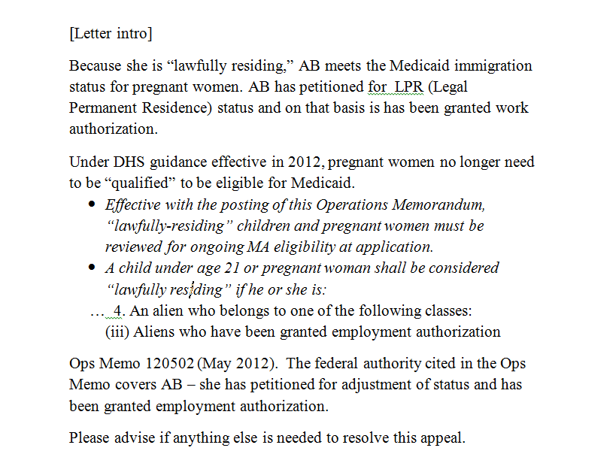

Slide 24
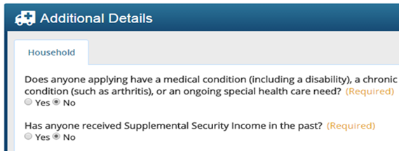
Verifying Disability
If applicant answers yes, EAF (PA 1663) requested
Note difference between COMPASS and PA 600 HC
Notes:
Common reason for delay / more than denial
EAF requested, but not required (if eligible in adult/expansion category)
Also triggers COMPASS to ask resource Qs

Slide 25
Applications
Timeframes & tactics

Slide 26
How to Apply
How quickly will an application be processed?
30 days – normally
45 days – if additional information needed
5 days – if applicant has a medical emergency
When does coverage start?
Date of application – normally
Up to 3 months prior – if applicant has unpaid bills
See MAEH 304.15, 304.5

Slide 27
How to Expedite
How quickly will an application be processed?
5 days – if applicant has a medical emergency
Submit basic letter from FQHC clinician describing the patient’s condition, asking CAO to process within 5 days.
Notes:
Don’t worry much about standard – “serious injury or death” – if consumer has diabetes and needs insulin, e.g., enough. Missing anti-depression meds, chronic pain …
- submit w/ the compass application verifications / paperwork. PHLP – typically after the fact.

Slide 28
Status Requests
For applications that are pending …
Ask your CAO contact:
What is the status of Jane Doe’s application?
Is any additional information needed?
If applicable:
Gently point out that application is over 30 days
Describe any medical conditions or unfilled prescriptions, ask that the CAO expedite
Include the Compass e-form number
Notes:
[Include Compass e-form#, if you have it] – or date reports filing

Slide 29
Example – pending application
Good afternoon Mr. Galinowski,
I’m writing to ask about the status of LM’s MA application. Her daughter reports filing an application through COMPASS on December 15th.
• E-form #: W1234567
• DOB: x/xx/56
Ms. M suffers from bipolar disorder and uncontrolled diabetes. See attached doctor’s letter and endocrinology report. If at all possible, please expedite her application pursuant to MAEH 303.13 on the basis of medical emergency.
Thanks for your assistance,
Kyle Fisher
Notes:
- medical piece adds a human element – even if you don’t have a doctor’s letter, know your client needs medications, etc, include that. 9/10, my clients have a health need. Share that information. Even if not legally relevant. Can spur action.

Slide 30
Resources
Blank Appeal Form (DHS) – PA FS 162 FS
Supplemental Handbook, Chapter 870 – Appeal & Fair Hearing
http://services.dpw.state.pa.us/oimpolicymanuals/supp/index.htm
Medical Assistance Eligibility Handbook
http://services.dpw.state.pa.us/oimpolicymanuals/ma/index.htm
Ops Memo #16-03-03
PHLP Medical Assistance Eligibility Manual
http://www.phlp.org/wp-content/uploads/2015/02/Eligibility-Manual-2015.pdf
PHLP Helpline: 1-800-274-3258
Kfisher@phlp.org

